Slide 1
BDA Mini Project
Sales Trend Prediction and Visualization using MongoDB
Team Members:
Apurva Lakeshri BEA102
Rishita Lolge BEA112
Sharmeen Gardi BEA115
Shreya Shetty BEA118

Slide 2
Introduction
In today's data-driven world, businesses continuously seek insights from historical sales data to optimize their strategies and enhance decision-making processes.
This project focuses on predictive analysis using historical sales data, with the objective of forecasting future sales trends.
By leveraging MongoDB, a NoSQL database known for its scalability and flexibility, we can efficiently store and process large datasets.
The analysis includes data aggregation, trend identification, and future sales predictions, followed by visualization for intuitive understanding.

Slide 3
Methodology
The project involves several key steps:
Data Preparation:
A collection named salesData is created in the MongoDB database salesDB.
Sample sales data is inserted, containing fields such as date, category, quantity_sold, and revenue.
Exploratory Data Analysis (EDA):
Aggregation queries are used to calculate daily total revenue from sales records.
This step involves grouping sales data by date and summing the revenue to identify sales trends over time.
Predictive Modeling:
A moving average method is implemented to forecast future sales based on historical data.
This model calculates the average revenue over a specific period, allowing for basic trend forecasting.
Data Visualization:
Using Python’s Matplotlib library, visualizations are created to display the daily sales trends and projected sales.
The visual representation helps in easily understanding the sales performance and the forecasted values.

Slide 4
Proposed System
The proposed system comprises the following components:
MongoDB Database:
A NoSQL database is used to store sales data efficiently. MongoDB's document-based structure allows for easy updates and retrieval of information.
Data Aggregation:
MongoDB's aggregation framework is employed to analyze sales data, providing insights into total sales per day and category.
Predictive Analytics:
A moving average model is implemented to predict future sales based on historical trends. This statistical approach allows businesses to prepare for upcoming demand.
Visualization Dashboard:
A Python script utilizing Matplotlib visualizes the sales trends. The dashboard includes charts displaying historical sales data and forecasts for future sales, making insights easily accessible for stakeholders.

Slide 5
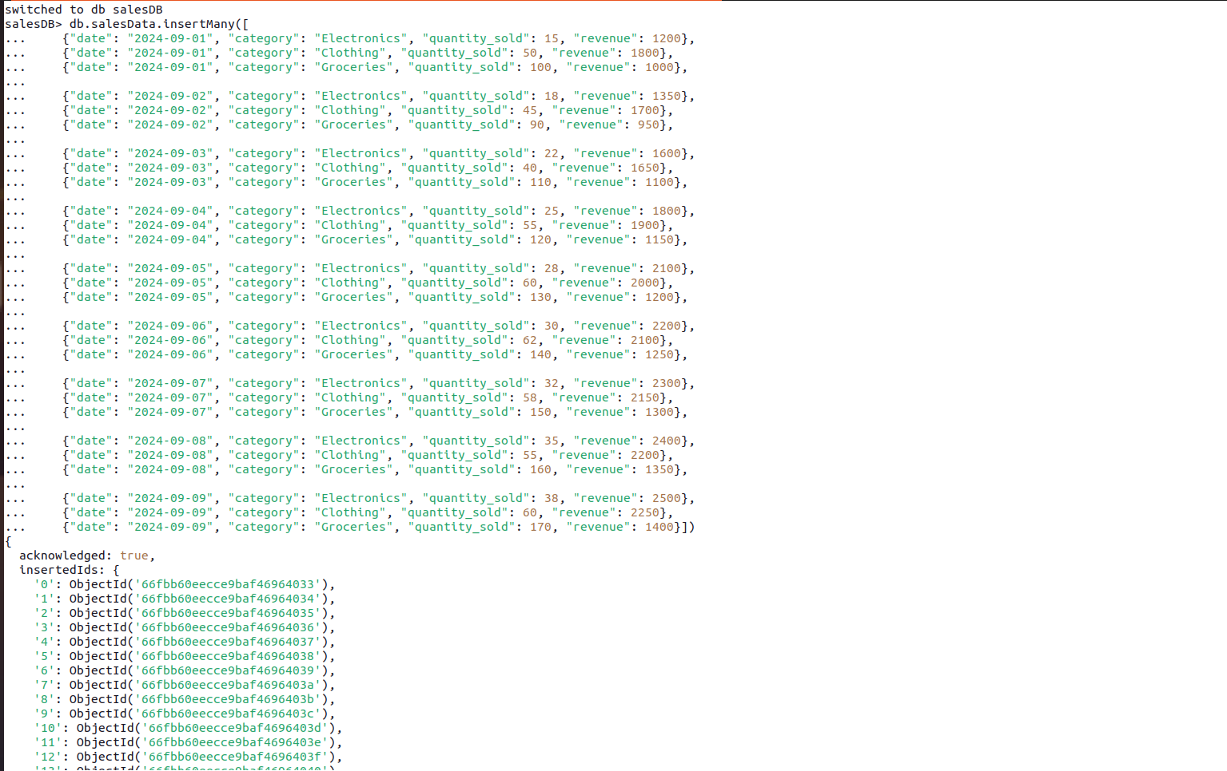
Creating Database

Slide 6
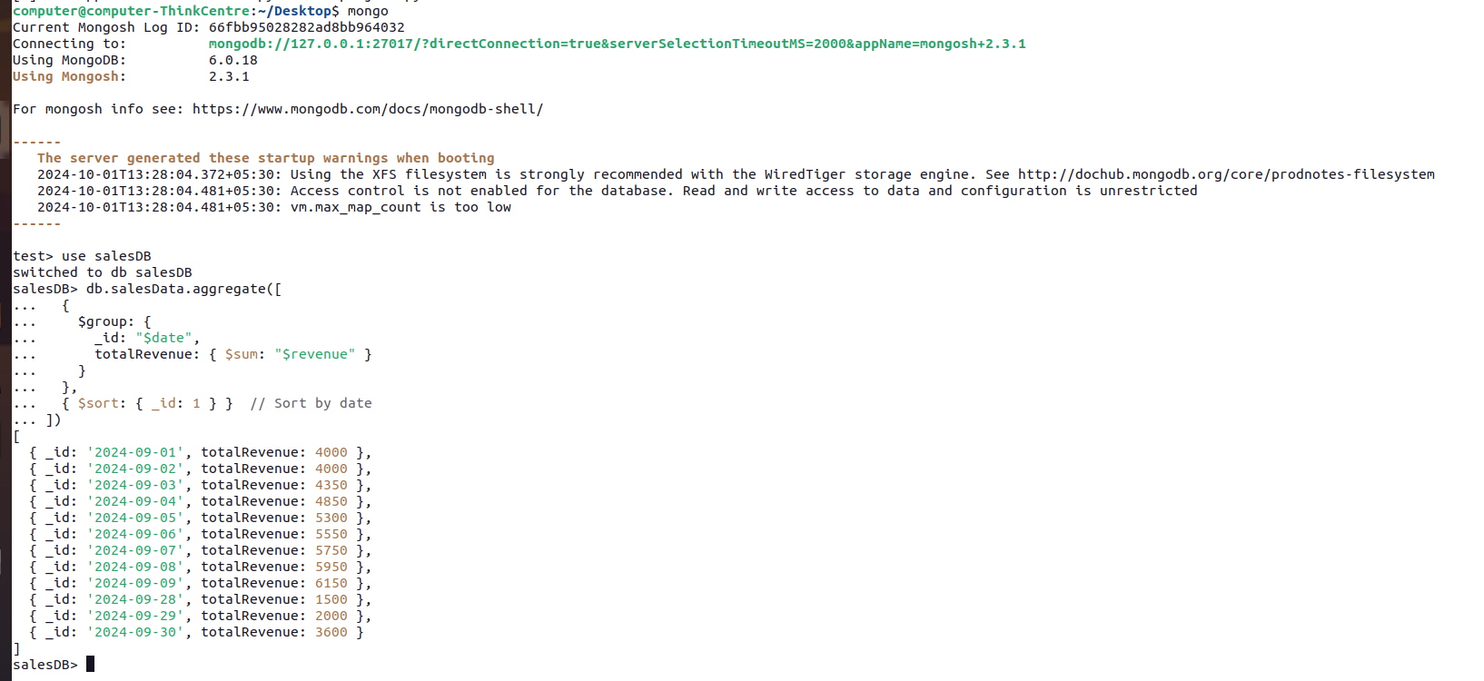
Total Revenue per Day
This will give you the daily total revenue, which you can use as a basis for predicting future revenue.

Slide 7
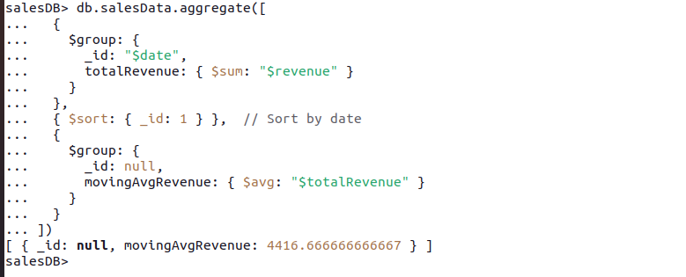
Predict Sales Using a Moving Average
This will return an average revenue over a specific period.
You can adjust the number of days used in the moving average by adding more logic to the aggregation pipeline.

Slide 8
Predict Future Revenue
Based on the moving average, we can make a simple projection for the next day by assuming the revenue will stay close to the moving average.

Slide 9
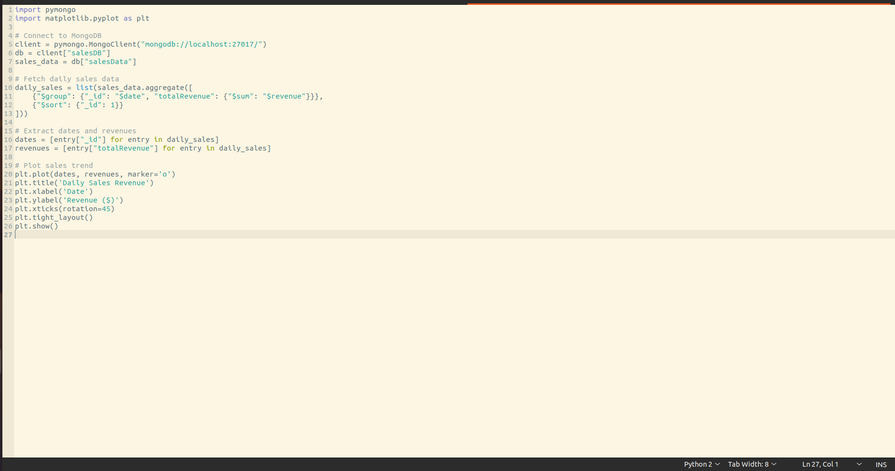
Visualization (Using Python and Matplotlib)

Slide 10
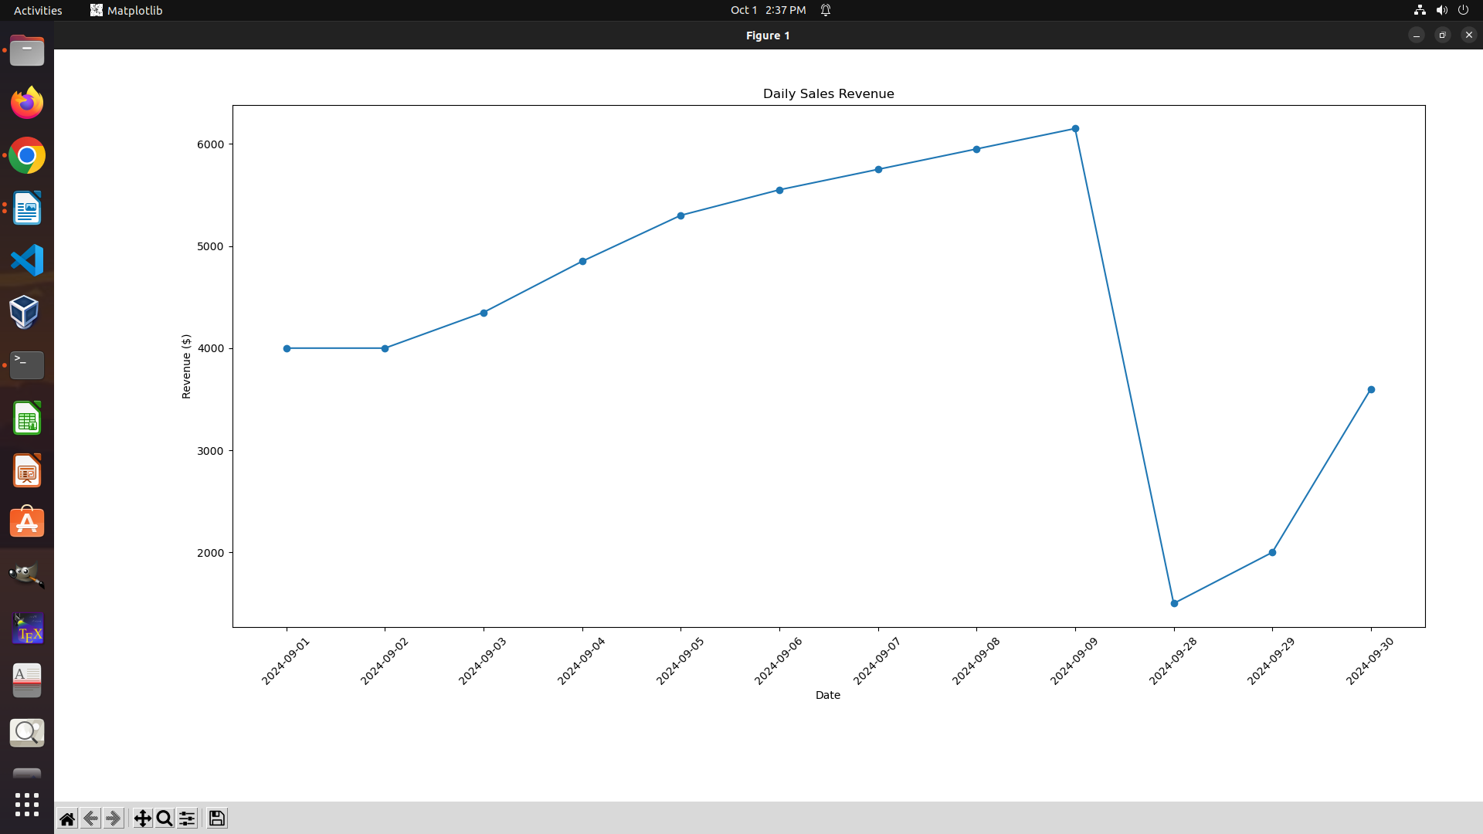

Slide 11
Conclusion
This project successfully demonstrates how to perform predictive analysis on sales data using MongoDB.
By aggregating historical data and applying a moving average forecasting model, we were able to derive actionable insights into future sales trends.
The visualization of these insights enhances understanding and aids in strategic decision-making for businesses.
As a result, this project highlights the potential of big data analytics in enhancing operational efficiency and optimizing business strategies.
Future work could involve implementing more sophisticated predictive models and incorporating machine learning techniques to improve accuracy and provide deeper insights.

